Slide 1
Lecture3.1_OPENAI GYM
Prof. Shivali Dhaka

Slide 2
OutLines
RL Setup
Explanation
Example
OpenAI Gym
Environments
Installation of OpenAI Gym
Basic functionality of GYM
Practical Example

Slide 3
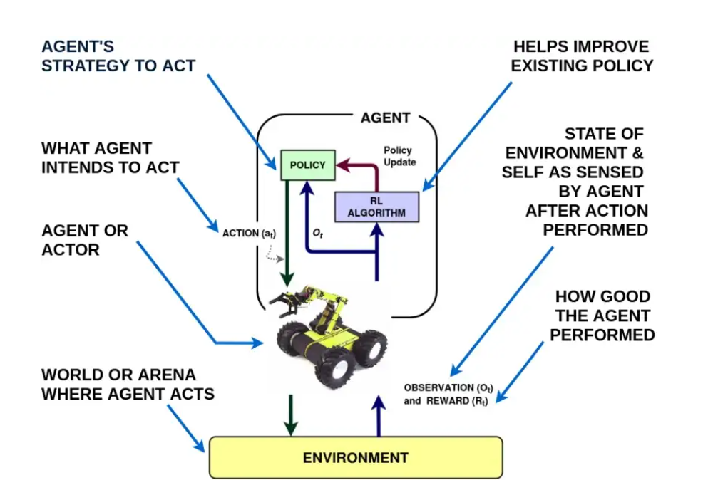
RL Set up
States, Observation and Action Spaces in Reinforcement Learning | by #Cban2020 | The Startup | Medium

Slide 4
Figure Explanation:
An Agent’s (e.g. the yellow robot) goal is to learn the best possible way to perform a certain task in an Environment. The agent tries to achieve that task by taking actions (e.g. move left, right or stop) as suggested by a strategy (or Policy). So after it performs that specific action the agent observes the state of the environment (Observation) and a goodness score (or Reward) based on its last action. These feedback information are then utilized by the RL algorithm to upgrade/ improve the existing strategy (or policy), for better performance in the future. An agent can learn to play and win strategy games, e.g. Pacman (from Atari games), in which case the Pacman is an agent and the gaming construct is the environment. Following is an example (MountainCar-v0) from OpenAI Gym classical control environments. OpenAI Gym, is a toolkit that provides various examples/ environments to develop and evaluate RL algorithms

Slide 5
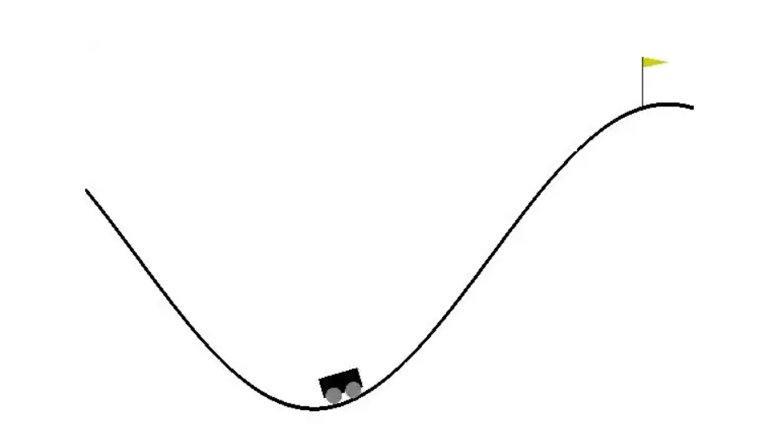
Example:
MountainCar-v0 : A car is on a one-dimensional track, positioned between two “mountains”. The goal is to drive up the mountain on the right; however, the car’s engine is not strong enough to scale the mountain in a single pass. Therefore, the only way to succeed is to drive back and forth to build up momentum. Lets connect the general RL terms learnt till now, in the context of this simple environment.
MountainCar-v0 Environment setup from OpenAI gym Classic Control

Slide 6
General RL terms in the context of this simple environment(Previous Slide).
Agent: the under-actuated car .
Observation: here the observation space in a vector [car position, car velocity]. Since this is a one dimensional problem, with a car moving on a curve like feature, its location is given by a continuous value between [-1.2,0.6] and the velocity is a bounded continuous value between [-0.07,0.07].
Reward: reward functions for these type of simulated environments are already built- in the environment code and in this case generates a reward = -1 for any transition from any state and reward=+100 when the agent reaches the objective (the flag).
Action: the action space is discrete in this case and given as [Left, Neutral, Right].

Slide 7
Contd…
Episode: A number of state and action sequence (~1000 in this case), along which the agent tries to complete the objective before re initiating .
A trajectory may be defined as a part of a full episode and so every trajectory may not be a full episode.

Slide 8
What is OPENAI GYM?
OpenAI Gym acts as an interface between the typical Markov decision process formulation of the reinforcement learning problem and a variety of environments, covering different types of problems the agent has to solve (from classic control to Atari video games), as well as different observations and action spaces.
Gym is completely independent of the structure of the agent that will be interfaced with, as well as the machine learning framework used to build and run it.

Slide 9
What is OpenAI Gym?
Providing a diverse range of environments within which to test your RL agents.
Collection of environments.
Most environments freely available.
Standardized environment API make comparisons between algorithms easier.
Test same RL algorithms on many different problems.
eg. Atari 2600 games.

Slide 10
Environments:
Classic Control and Toy Text: Simplest environments based on RL literature that are beginner friendly. The 'CartPole' environment, which belongs to this category, can be thought of as the 'MNIST' of RL. These environments are the best place to start in order to gain confidence with Gym and to familiarize yourself with agent training.
Algorithmic: The aim here is to learn to imitate computations. In these environments, the system has to learn, autonomously and purely from examples, to perform computations ranging from multi-digit additions to alphanumeric-character sequence reversal.
Atari: Provides an easy to use form of the Arcade Learning Environment, which provides access to over 50 Atari games by building over the Atari 2600 emulator.
Box2D, MuJoCo and Robotics: This focuses on learning continuous control tasks. 'LunarLander' is the most commonly used environment belonging to this category.
Gym Documentation (gymlibrary.dev)

Slide 11
How to interact with GYM environment
In order to interact with a Gym environment, it has to, first of all, be created and initialized. The Gym module uses the make method, along with the ID of the environment as an argument, to create and return a new instance of it. To list all available environments in a given Gym installation, it is sufficient to just run the following code:
from gym import envs
print(envs.registry.all())
This is a list of so-called EnvSpec objects. They define specific environment-related parameters, such as the goal to be achieved, the reward threshold defining when the task is considered solved, and the maximum number of steps allowed for a single episode.

Slide 12
The fundamental elements of an environment.
Observation (object): An environment-specific object representing what can be observed of the environment; for example, the kinematic variables (that is, velocities and positions) of a mechanical system, pawn positions in a chess game, or the pixel frames of a video game.
Actions (object): An environment-specific object representing actions the agent can perform in the environment; for example, joint rotations and/or joint torques for a robot, a legal move in a board game, or buttons being pressed in combination for a video game.
Reward (float): The amount of reward achieved by executing the last step with the prescribed action. The reward range differs between different tasks, but in order to solve the environment, the aim is always to increase it, since this is what the RL agent tries to maximize.

Slide 13
Done (bool): This indicates whether the episode has finished. If true, the environment needs to be reset. Most, but not all, tasks are divided into well-defined episodes, where a terminated episode may represent that the robot has fallen on the ground, the board game has reached a final state, or the agent lost its last life in a video game.
Info (dict): This contains diagnostic information on environment internals and is useful for both debugging purposes and for an RL agent training, even if it's not allowed for standard benchmark comparisons.

Slide 14
The fundamental methods of an environment:
reset(): Input: none, output: observation. Resets the environment, bringing it to the starting point. It takes no input and outputs the corresponding observation. It has to be called right after environment creation and every time a final state is reached (done flag equal to True).
step(action): Input: action, output: observation – reward – done – info. Advances the environment by one step, applying the selected input action. Returns the observation of the newly reached state, which is a reward associated with the transition from the previous to the new state under the selected action. The done flag is used to indicate whether the new state is a terminal one or not (True/False, respectively), as well as the Info dict with environment internals.

Slide 15
render(): Input: none, output: environment rendering. Renders the environment and is used for visualization/presentation purposes only. It is not used during agent training, which only needs observations to know the environment's state. For example, it presents robot movements via animation graphics or outputs a video game video stream.
close(): Input: none, output: none. Shuts down the environment gracefully.

Slide 16
Installation of OpenAI Gym
pip install gym
This command allows the use of environments belonging to Classic Control, Toy Text and Algorithmic categories, but to use an environment such as Breakout from Atari, or LunarLander from Box2D, one is required to perform an extra pip install step.
For using Atari Environments
pip install gym[atari]
For using Box2D Environments
pip install gym[box2d]

Slide 17
To test whether your installations have been completed successfully, ensure that the following section of Python code results in no errors.
>>> import gym
>>> gym.make('CartPole-v1')

Slide 18
Basic Functionality of the Gym
gym.make(env_id): is used to create an instance of the target environment
import gym
env = gym.make('CartPole-v1’)
env.reset(): is the first function to be called, before any interactions can be performed between the agent and the environment. It initialises the environment by placing the agent at the start position, and in turn returns the initial observation, i.e the state of the environment.
state=env.reset()
env.step(action): performs the agent action, passed as an argument to the function, within the environment and returns the next state, reward, done and info. Next state contains the observation of the environment that has resulted from the agent performing the action in the environment. The reward acts as a signal to guide the agent towards learning more of the behaviour that accomplishes the desired task, while suppressing the actions that cause the agent to stray away from the goal. Done is a boolean flag that determines whether the terminal state has been reached or not. Info is used to capture additional information from the environment, and is usually an empty dictionary.
next_state, reward, done, info = env.step(action)

Slide 19
Basic Functionality of the Gym contd….
4. env.render(): is useful for studying how the agent is interacting with the environment. It renders the environment states as RGB frames, which appear to the human eye as a video depicting agent-environment interactions.
env.render()
5. env.close(): performs the necessary cleanup to close the environment. By default, environments usually close themselves when the program exits, however, using env.render might cause the program to throw out an error message while it exits, and this can be avoided using env.close().
env.close()

Slide 20
Basic Functionality of the Gym contd….
6. env.action_space and env.observation_space: are instance variables that define the type and range of the states that the agent can observe and actions that the agent can perform. The two most common types of space are 'Box', which is used for the continuous domain, and 'Discrete’.
env.action_space
env.observation_space
For example, in the CartPole environment, at each step, the agent receives as input an array of real numbers of size 4 as the state information and can perform 2 actions, as indicated by Box(4,) and Discrete(2) respectively.
>>> import gym
>>> env = gym.make('CartPole-v0')
>>> env.action_space
Discrete(2)
>>> env.observation_space
Box([-4.8000002e+00 -3.4028235e+38 -4.1887903e-01 -3.4028235e+38], [4.8000002e+00 3.4028235e+38 4.1887903e-01 3.4028235e+38], (4,), float32)

Slide 21
Basic Functionality of the Gym contd….
Additionally, you can determine the range of values that action_space and observation_space can take. To determine the range for Discrete space, use the 'n' instance variable. For the CartPole environment, using the 'n' instance variable with action_space would return '2', which means the agent can take two actions which are represented as 0 and 1. Similarly, for the Box space, as represented by the observation_space in the CartPole example, 'high' and 'low' are used to determine the upper and lower bounds.
>>> env.action_space.n
2
>>> env.observation_space.high
array([4.8000002e+00, 3.4028235e+38, 4.1887903e-01, 3.4028235e+38],
dtype=float32)
>>> env.observation_space.low
array([-4.8000002e+00, -3.4028235e+38, -4.1887903e-01, -3.4028235e+38],
dtype=float32)

Slide 22
Basic Functionality of the Gym contd….
7. env.action_space.sample(): allows you to sample an action uniformly at random from all the possible actions available to the agent.
action=env.action_space.sample()

Slide 23
Famous RL Algorithms
Deep Q Network(DQN): Learns to play Atari video games with superhuman skills.
AlphaGo -> AlphaZero -> MuZero: Learns to play Go, has beaten the best human players.
Proximal Policy Optimization(PPO):Learns to play DOTA2

Slide 24
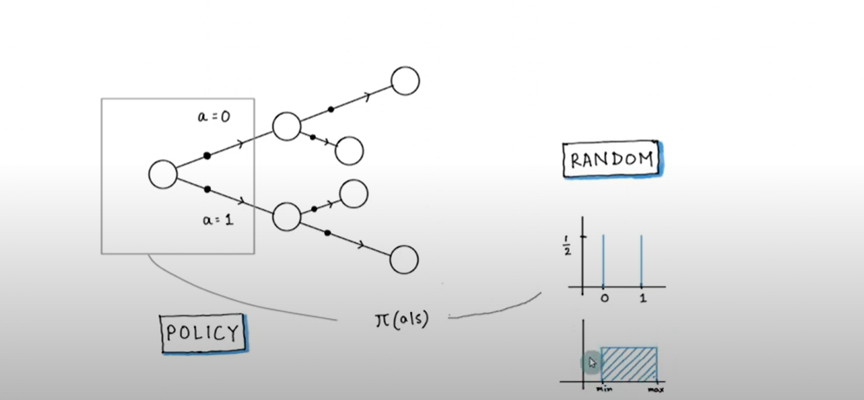
RL Algorithms start by taking random actions(exploration)
There is no teacher to tell the correct action.
The agent must try out different actions to find out their consequent immediate reward and next state.
states
Continuous Action spaces

Slide 25
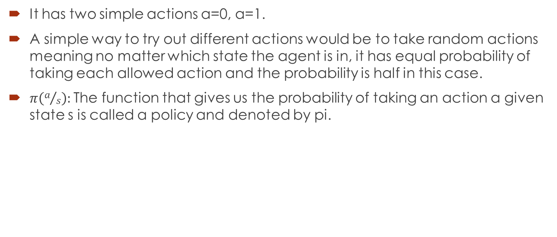
Example of CartPole(previous slide)..
It has two simple actions a=0, a=1.
A simple way to try out different actions would be to take random actions meaning no matter which state the agent is in, it has equal probability of taking each allowed action and the probability is half in this case.
$π\left(a/s\right):$The function that gives us the probability of taking an action a given state s is called a policy and denoted by pi.

Slide 26
Resources:
OpenAI Gym Official Website: https://gym.openai.com
Official Git Repo of OpenAI Gym: https://github.com/openai/gym
Official documentation listing the environments available in OpenAI Gym: https://github.com/openai/gym/blob/master/docs/environments.md
Code describing the structure and methods of the Gym environment class: https://github.com/openai/gym/blob/master/gym/core.py
A short read describing the design decisions behind OpenAI Gym: https://arxiv.org/pdf/1606.01540.pdf

